Slide 1
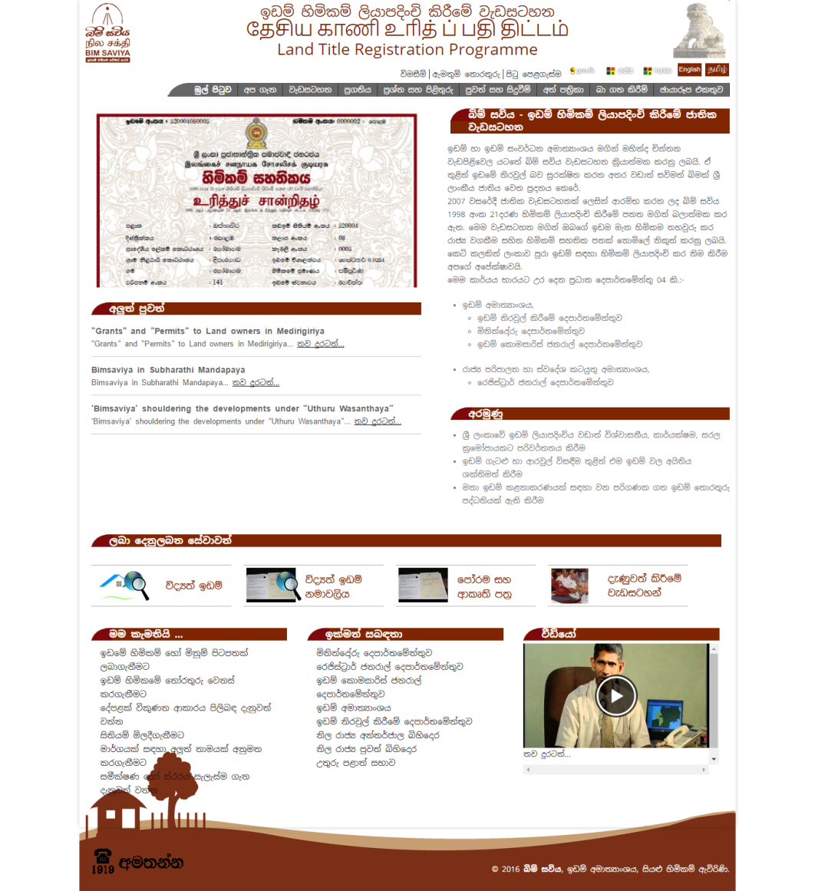
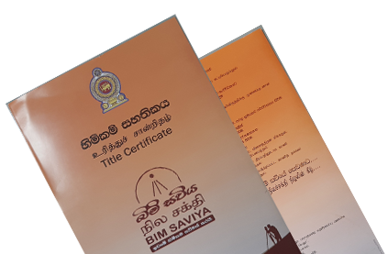
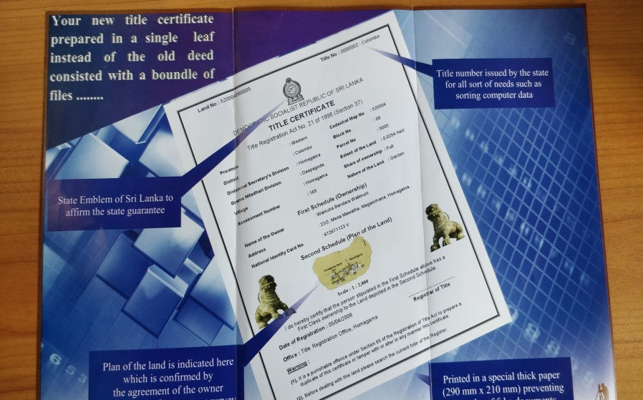
Registration of Title
Topic No.03

Slide 2
Learning Strategies
5Ws & 1H strategy
After the lecture
Before the lecture
Do the reading
5 WS & 1H Strategy
WHAT
WHO
WHY
WHERE
WHEN
HOW
2. Draw up charts
3. Mark key words
(e.g. shall, may)
4. Categorize sections
During the lecture
5. Pay attention in the lecture
6. Participate in the lecture
7. Answer to the following questions

Slide 3
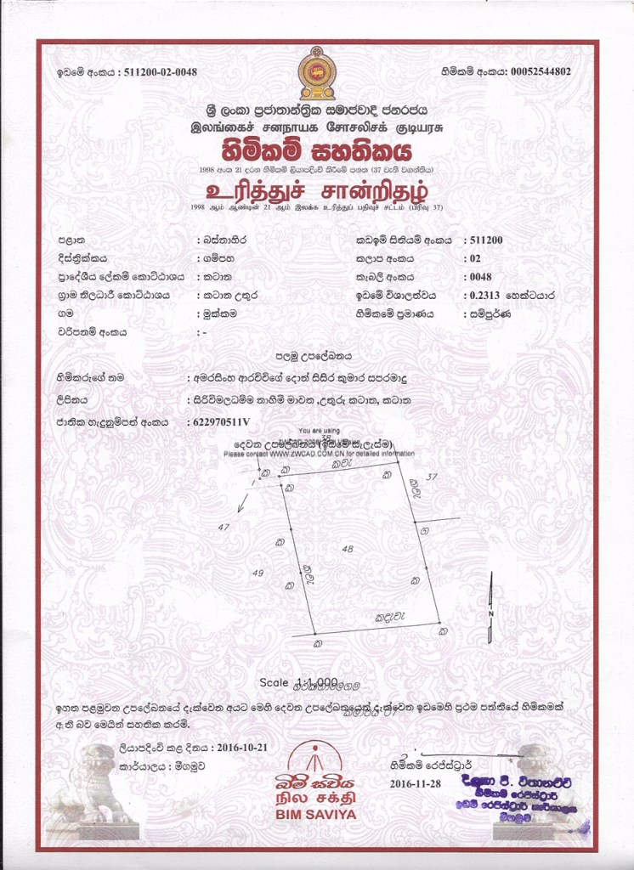
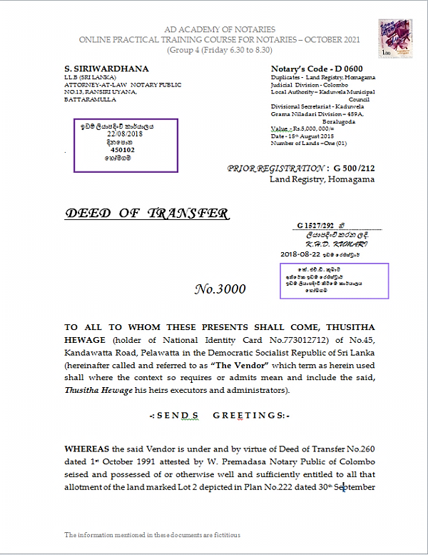
Registered Deed and Title Certificate

Slide 4
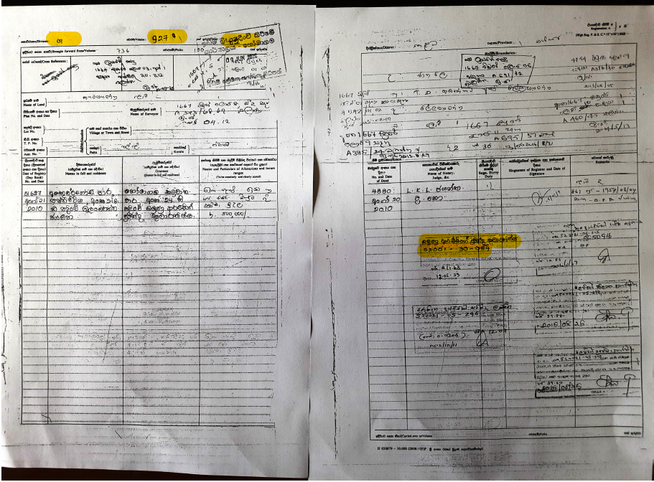
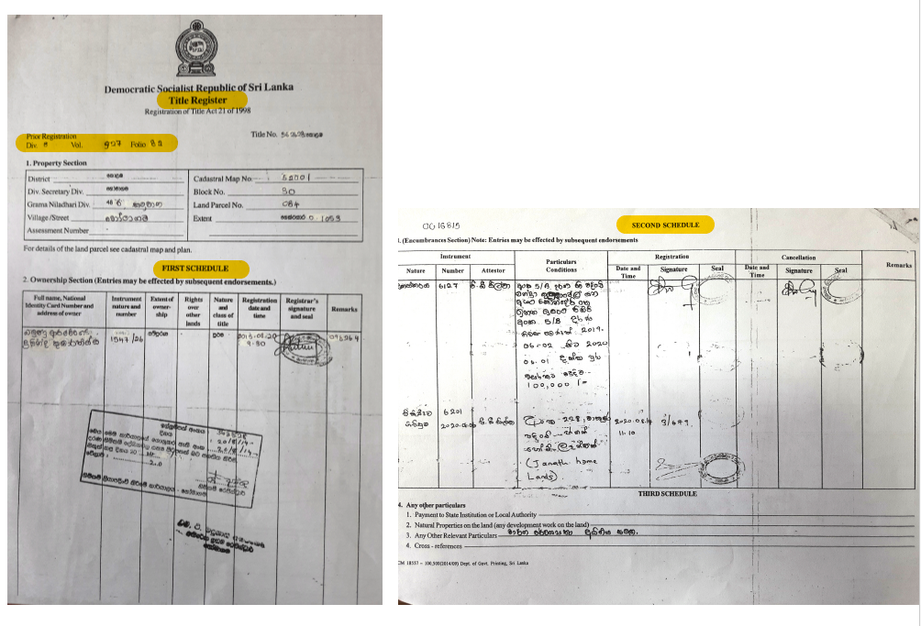
Registration of Document Folio and Title Registry

Slide 5
INTERPRETATIONS AND ABBREVIATION-FC-01
SECTION 75 OF ACT NO.21 OF 1998
Instrument
A document having the effect of conveying title to and interest in any land parcel in the prescribed form
Interest in land parcel
An interest less than full ownership of the land parcel.
And includes any Servitudes or encumbrance over such land parcel
Includes land covered with water, and any benefit arising out of any land, all things attached to the earth or permanently fastened thereto
Land
An auctioneer licensed under the Auctioneers and Brokers Ordinance (Chapter 109)
Licensed auctioneer
The Minister to whom the subject of lands has been assigned
Minister
a) in relation to a land parcel the person named in the Title Register as the owner thereof, and;
b) in relation to an interest in a land parcel, the person named in the register as the person in whose favour the interest is registered;
Owner
Land parcel
An area of land separately delineated on the cadastral map

Slide 6
Commissioner of Title Settlement
(CTS)
Commissioner of Title Settlement who shall be responsible for the due performance of the duties and functions assigned to him under RTA and such number of
Deputies and Assistants as may be necessary
Registrar-General of Title (RGT)
Includes any Deputy or Assistant
Registrar of Title (RT)
Any person appointed as Registrar of Title under this Act.
Registered land
A land parcel the title to which is registered under this Act;
Servitude
A right enjoyed by a person over a land parcel owned by another person
Surveyor-General (SG)
The officer appointed as Surveyor-General of Sri Lanka or any other officer appointed in writing to act on his behalf for the purposes of RTA to the extent specified in such letter of appointment
Superintendent of Surveys (SS)
Any person performing the functions of a
Superintendent of Surveys in the Survey Department (SD)
Title Register
(TR)
The Title Register under the provisions of this Act
(TR)
Unit of Record
A Title Register maintained under section 3 shall be a land parcel shown on the cadastral map

Slide 7
PREAMBLE
Investigation of rights to Land Parcels
2) Registration of Titles
Registration of Title Act No.21 of 1998
3) Transactions
4) Connected matters
Parts of RTA
PRELIMINARY (Ss. 2 to 9)
P
A
R
T
OF
R
T
A
REGISTRATION OF TITLE INITIAL COMPILATION (Ss.10 to 33)
INSPECTION OF REGISTER AND ISSUE OF CERTIFIED COPIES (Ss.34 to 35)
SUB-DIVISION AND AMALGAMATION (Ss.36 to 37)
TRANSACTIONS RELATING TO REGISTERED LAND (Ss.38 to 49)
STRATA TITLES (Ss.50 to 53)
RETENTION OF INSTRUMENTS (S. 53)
TRANSMISSION OF TITLE (Ss. 54 to 56)
GENERAL (Ss.57 to 75)

Slide 8
OBJECTIVES & EFFECT OF REGISTRATION
Objectives
REGISTRATION OF TITLE (ROT)
NO person acquire any interest or title unless it is registered (S.38)
Transactions relating to a land parcel to be made in accordance with Act S.39
Instrument to take effect on registration S.49
DIFFERENCE BETWEEN EFFECTS OF REGISTRATION UNDER ROD & RTA
Publicity
Vested absolute Ownership (S.32)
Conclusive Evidence of Title
[Cannot question in any Court of law] (S.33)
Prevention (Avoidance ) of frauds
Effect of registration under
ROD
Effect
of Registration
with a 1st class title
(RTA)
Priority
No Prescription (S.57)
No Partition actions (S.63)
Protect buyers (in good faith)
Indemnity (S.60)

Slide 9
OFFICERS
MINISTER
(Land and Land Development)
Commissioner of Title Settlement (CTS)(S.2)
Surveyor General (SG)
Registrar General of Title (RGT) [S. 3(1)]
of Superintendent Surveyor (SS)
Registrations of Title (RT) [S. 3(3)]
Manager (Co-owned land)[S. 15(1)]
Conciliation Board (S.7)

Slide 10
(s.7)
INVESTIGATION & SETTLEMENT OF CLAIMS (Part 1)-(Institutions)
Institutions
Refer (for assistance (s.7)
Conciliation Board (s.9)
Commissioner of Title Settlement (CTS) (s.12)
District Court (S.21)
Cadastral Map prepared by Survey General (s.12)
Member[[Ss.3-7]
Grama Niladhari [s.7 (2) (b)]
Publication of Notice in the Gazettes (s.13)
Land holders (S.7(2)(a)
Absolute ownership & 1st class title [S.14]
Declaration (S.14)
Bonafide possession & 2nd class title [S.14 (b)]
Portion & 1st or 2nd class title (S.14.c)
Co- ownership (S.14.d)

Slide 11
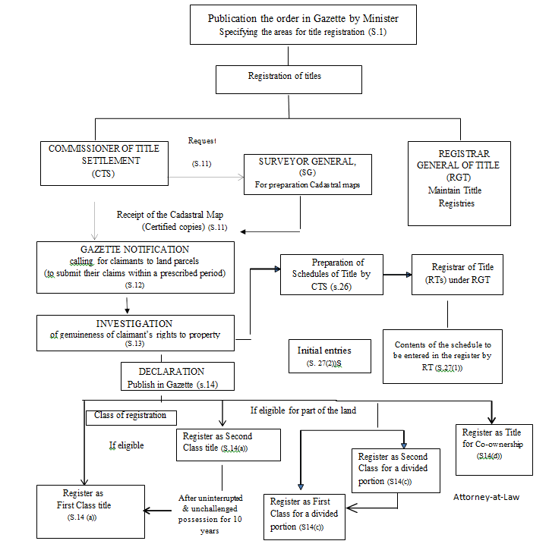
Process of Title Registration Part 1
Registration of Title Act No.21 of 1998.
INITIALCOMPILATION- FC-07 (RGD)

Slide 12
INITIALCOMPILATION
Specify the area (by the Minister) (S.1)
RGT –Register General of Title
SG- Surveyor General
CTS- Commissioner of Title Settlement
RT- Registrar of Title
TR- Title Registration
DC- District Court
On the request by CTS
Prepare cadastral map by SG (s.11)
CTS (s.11)
Publication of Notice in the Gazette (s.12)
Reference of claims to DC by the CTS
(if he forms an opinion –due to the nature of the claim/s) (S.21)
Calling for claimants (s.12)
Absolute Ownership 1stClass (s.14 (a)
Investigation of Title (s.13)
Absolute Ownership 2nd Class (s.14 (b)
Claimants aggrieved by any declaration made by CST under S.14 (S.22)
Determination (s.14)
Publish in Gazette (s.14)
Portion (a part of the land parcel) (s.14 (c)
Preparation of Schedule of Title (s.26)
Co-owners (s.14 (d)
dispatch
Register of Title (S.26)
SG
copy
Title (initials entries) [S.27(2)]
Issuance of Certificate of Title (S.37)
Owner / Interest holder of the land parcel [S.37]

Slide 13
INVESTIGATION & SETTLEMENT OF CLAIMS
REFERENCE OF CLAIMS TO DISTRICT COURT Part-1
refer
District Court
(for investigation & determination)
Appeal
Claimants aggrieved by any declaration made by CST under S.14
Commissioner of Title Settlement
(forms an opinion –due to the nature of the claim/s)
(s.21)
(s.22)
Inquiry (s.24)
Order
Declaration of title
(in accordance with determination under S.14) [S.24(a)]
Sale of Land (whole or divided portion)
[S.24 (b)]
Cost of action [S.24(c)]
Commission to SG
(for additional surveys
& amendments for of cadastral maps to give effect to order)
[S.25(1)]
Commission to Licensed Auctioneer
to conduct the sale [S.25(4)]
Whole land parcel (s.24)
Divided Portion
Return (S.25(2)
Return (S.25(4)
District Court
Judgment & decree (S.25(6)(b)]
Dispatch a copy of the decree
Commissioner of Title Settlement

Slide 14
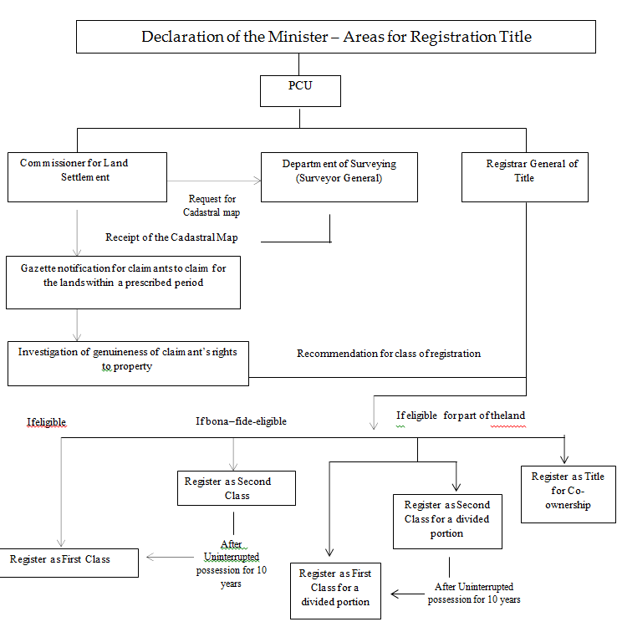
Process of Title Registration
INITIAL COMPILATIO (RGT)

Slide 15
TRANSMISSION OF TITLE
(Sections 54 & 55 of Registration of Title Act No.21 of 1998)
Registered Owner (dies)
testate
intestate
TESTATE ESTATE (s.54(1))
INTESTATE ESTATE
[S.55(1)]
Any person who becomes the owner by virtue of
1)Court Order or
2. Certificate of Sale
[Ss.56(1)]
Inform the death (by any Interested person) [Ss.55(1)]
1.Probate of the Will
2. Instrument (Executor’s Conveyance) [S. 54(1)]
to be forwarded subject to Ss. 54(2) & (3).
COMMISSIONER OF TITLE SETTLEMENT [S.55(1)]
APPLICATION
(with supporting documents [Ss.56(2)]
REGISTER OF TITLE
(RT)
Publication of NOTICE (for claimants)(CTS) [S.55 ](2)]
REGISTER OF TITLE (RT)
SECTIONS 13, 14 20, 21, 22, 23, 24, 25, 26 & 27 be applicable [S.55(3)]
Register in the Title Register
[Ss.55.(2)]
Register in the Title Register

Slide 16
SUB-DIVISION & AMALGAMATION
(Section 36 of Registration of Title Act No.21 of 1998)
By registering a Plan of redivision or amalgamation
DECLARATION (S.36(2)
Particulars of every encumbrance.
Lis Pendens, seizure. Order or decree (if any)(s.36 (2) (a).
References to Title Register & Cadastral Map(s.36 (2) (b).
A Survey Plan (made by a private Registered Surveyor)
with reference to Cadastral map (C/Map) & showing the proposed
sub-division/ amalgamation
[s.36 (2) (c)]
OWNER/S
[S.36(1)]
APPLICATION
(for sub-division or amalgamation
[shall contain a declaration] [s.36 (2)]
ORIGINAL
COPY
REGISTRAR OF TITLE
(RT)
Superintendent of Surveyors
(SS) [S.36(3)]
NOTIFY Applicant about the certification of the plan
If SS is satisfied, that
Plan conform to cadastral Map & Regulations [Ss.36(3)]
FORWARD
AND make necessary amendments showing the sub-division or amalgamation on the cadastral map
with a Certification on behalf of SG [Ss.36(3)]
A copy of the section of cadastral map showing the amendment [s.36(3)]
Original Plan (tended by the Applicant) be filed of record in the office of SS [s.36(4)]
REGISTRAR OF TITLE (RT)
Application & Documents to be filed in the relevant file [Ss.36(5(b)]
On receipt of relevant section of the C/Map from SS if RT satisfied such app for Sub/Amalgam. conforms the provision of RTA and regulations [s.36(5)]
Register in the Title Register
(with cross reference to former) [S.36.(5)]

Slide 17
STRATA TITLES- FC11
Registration of horizontal sub-division of buildings
Sections 50 to 52 of Registration of Title Act No.21 of 1998
[Subject to the provision of Apartment Ownership Law No.11of 1973)(AOL)]
OWNER (Applicant)
[of building with more than one story
registered under RTA [s.50 (1)]
APPLICATION (for the registration of the
Con/Plan) (in the prescribed form) +
CONDOMINIUM PLAN + Fee
(for registration of Condominium Plan) [s.50 (1)]
Content of the application
Reference number of the land parcel
Number of Con/parcels depicted on the cadastral map [S.50(2)]
REGISTRAR-GENERAL OF TITLE
(RGT) [s.50 (1)]
refer – Application, Condominium Plan & Cadastral Map
SUPERINTEND OF SURVEYORS for certification (s.50 (3))
forward [S.51(b)]
If SS is satisfied that the Con/plan conforms the provisions of AOL & RTA he shall certify the Con/plan on behalf of SG (S.51)
Duplicate of Condominium Plan & Application of the owner [s.51 (b)]
File the original Con/plan after making suitable reference on Cad/Map (used) [Ss.51(a)]
1.file the duplicate of con/plan in
the Parcels File.
2. open a new title register
3 register each parcel and
4.make suitable cross references
[Ss. 52(a) to (d)]
REGISTER OF TITLE
If RT satisfied that the Application conforms to provisions of RTA & AOL (s.52)
Inform & Issuance of Title Certificate to the
APPLICANT [s.52(f)]

Slide 18
GROUNDS FOR REFUSAL to register by Registrar (S.45(2)
If not drawn according to the Provisions of this Act.
If the land parcel not identified and described accurately and conforms with registers in the Title Registry
REGISTRAR
(of Title)
Refuse to register the instrument
If the executant has no capacity to execute
If the title or interest conveyed identified ambiguous. And does not conform to that reordered

Slide 19
ACTION UNDER S.29 OF RTA FOR AMENDMENT OF THE REGISTER
(DISTRICT COURT Proceedings Part 2)
PERSON
(with a 2nd class title of ownership) aggrieved by registration
file
(within 10 years)
DISTRICT COURT
(for amendment of the register)
(s.29)
INQUIRY (s.30)
Notice of action to be registered in the encumbrances section of the register [S.29(2)]
Order
THE AMENDMENT
(s.30 (2) (a)
Registrar of Title
[S.30(2)(b)
Survey General
Commissioner of Title Settlement

Slide 20
REGISTRATION PROCEDURE
Present by any person
Presenting of Documents for registration
(within 7 days) (S.40)
Claiming any interest or benefit
Having any interest or charge on the land effected
Attesting such instrument
Counter at Title Registry
Present through post
Day Book (S.41)
Register the Instrument
(If all requirements are complied with)
Registration
IF NOT refuse to register
If it is a transfer, Registrar will issue a
NEW Certificate of Title
Return of Document
[Ss. 45(3)]
If it is a MB or LA - return the old Certificate of Title with and endorsement document by RT.

Slide 21
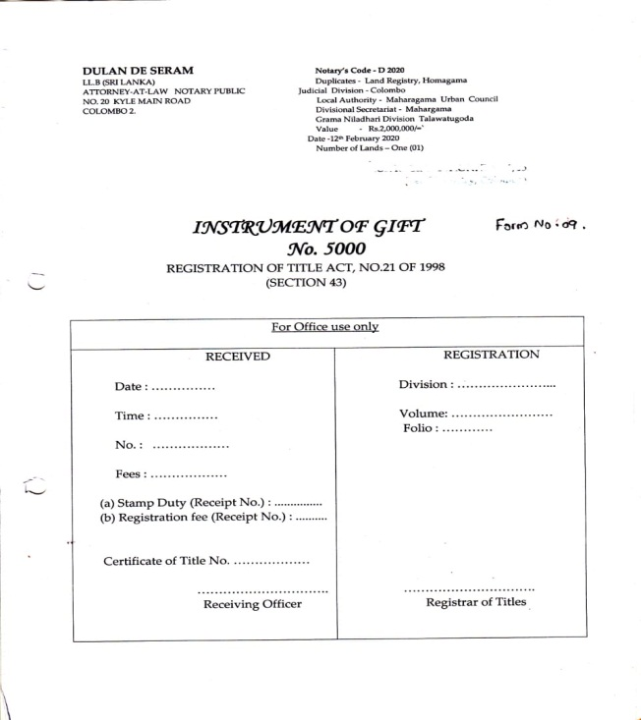

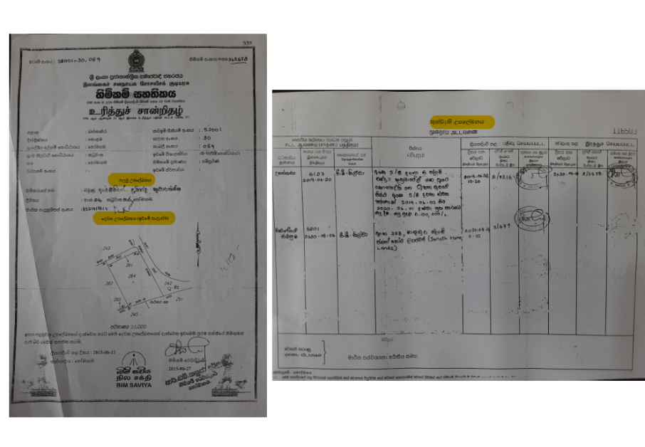

1. RDO Folio 2. unregistered instrument
Before registration
Title registry Folio
Title Certificate
After Registration

Slide 22
Forms and other regulations
Gazette (Extraordinary) No.1050/10 of 21st October 1998
Gazette (Extraordinary No. 1886/58 of 31st October 2014
Gazette (Extraordinary No. 2308/27 of 01st December 2022

Slide 23
CIVIL & CRIMINAL LIABILITIES OF NOTARIES
Section 45 (1) (b)- (Attestor to forward instruments attested within 7 days)
Failure to forward the attested instrument within the stipulated period shall be an offence punishable with the prescribed penalty.
Imprisonment exceeding 1 year
OFFENCES (S. 64)
Surveyor General
misleads
Offence
Any person
Commissioner of Title Settlement/Register General of Title or
Fine not exceeding Rs.5000/-
deceives
Both imprisonment and fine
Assistants
OFFENCES RELATING TO REGISTERS(S.65)
Issues or makes or /procures the issue or making of any extract
Imprisonment
not exceeding 3 years
Any person fraudulently
Offence
Removes from a registry
Fine not exceeding Rs.15,000/-
Defacement, obliteration, mutilation to any instrument
mutilation
Both imprisonment and fine

Slide 24

The End
Thank for your attention
Next seminar on:
Rules of Notary
(Topic 04)
On 26 /01/2023 (Thursday)

